Slide 1
Method of Hyperparameter Optimization of a Genetic Algorithm applied in Critical Scenario Generation for Autonomous Vehicles Master‘s Thesis Presentation

Slide 2
Introduction
Method for critical traffic scenario generation
Can be used to validate safety of autonomous driving systems
Implementation:
Autonomous driving functionality is applied on the EGO vehicle
Genetic Algorithm optimizes the criticality of the traffic scenario
Controls all other vehicles and pedestrians (NPCs) in the simulation
The Cumulated Emergency Brake Duration of the EGO vehicle is the chosen criticality measure

Slide 3
Research Questions
Q1: Is a genetic algorithm suitable for generating critical driving scenarios compared to random search?
Q2: Can the performance of a genetic algorithm be improved by optimizing the control parameter using the Taguchi method?

Slide 4
Simulation Setup
Traffic Manger provides a traffic simulation
Vehicles and pedestrians move through the simulation in a realistic manner
Provides an interface to alter individual actor behaviour through actions
Example actions: LaneChange, JunctionSelection, ModifyTargetVelocity, CrossRoad, etc …
Genetic Algorithm optimizes the fitness function by directing NPCs through actions
Traffic Manger
Genetic Algorithm
Cost
Action Interface
NPC 1
NPC 2
NPC 3
…

Slide 5
Genetic Algorithm Overview
Search algorithm inspired by the process of natural selection
Can efficiently navigate large search spaces
Population-Based Optimization:
Operates on a population of potential solutions (i.e., individuals)
Solutions evolve over multiple generations
Fitness function guides the selection of better individuals
Utilizes crossover and mutation as genetic operators for reproduction
TODO: explain Solution vs individual vs chromosome

Slide 6
Genetic Algorithm Chromosomes and Crossover Operation
Chromosome – TODO: prop move to prev slide
Consist of a list of genes and form a solution to the search problem
Custom encodings are required
Two different encodings were designed and compared
Both encodings contain the actions for all NPCs for a whole simulation
Crossover Operation Comparison
Two Point Crossover
0
1
2
3
4
5
6
7
8
9
10
11
12
13
14
15
16
17
18
19
0
1
2
3
4
5
6
7
8
9
10
11
12
13
14
15
16
17
18
19

Slide 7
Hyperparameter Tuning
Literature review
Recommended hyperparameter combinations gathered from existing literature
32 different hyperparameter combinations tested over 5 repetitions
Taguchi Method
Required 16 experiment runs over 8 repetitions
Optimized:
Three 4-level factors
Four 2-level factors
One interaction

Slide 8
Hyperparameter Tuning – Taguchi Method
Developed by Genichi Taguchi for robust optimization
Part of Design of Experiment
Systematic approach for process optimization
Identifies factors (i.e., hyperparameters) impacting performance using ANOVA
Identifies optimal factor-level (i.e., setting for each hyperparameter) combination
Advantages of Taguchi Method:
Robustness, Cost-Efficiency, Simplicity
Orthogonal Arrays:
Each factor is varied at different levels across different experimental trials
Ensures that the effects of each factor and their interactions are isolated
Notes:
While there are some other aspects to the Taguchi Method, I mainly focused on orthogonal arrays

Slide 9
Genetic Algorithms Comparison
Hyperparameter Combinations
Settings | Literature Review | Taguchi Method
Number of Generations | 30 | 30
Population Size | 96 | 96
Crossover Type | Two Point | Uniform 0.5
Crossover Rate | 0.8 | 0.9
Mutation Rate | 0.2 | 0.3
Tournament Size | 4 | 4

Slide 10
Evaluation
Comparison between:
Optimized Genetic Algorithm – uses the resulting values from the Taguchi method
Default Genetic Algorithm – uses best values from the literature review
Random Search
Each algorithm was tested on
4 different start scenarios
10 repetitions per start scenario
Statistical Tools used:
T-test
Effect size

Slide 11
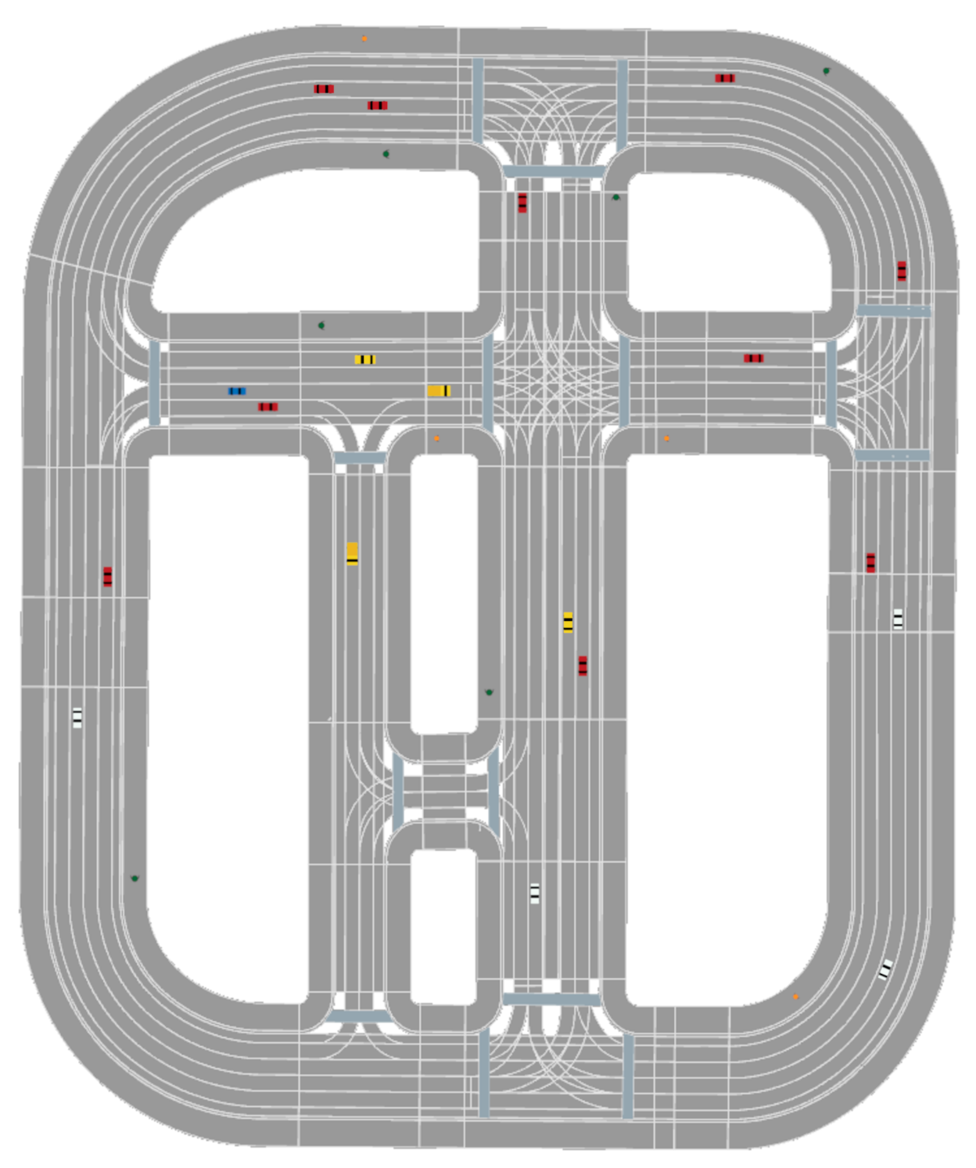
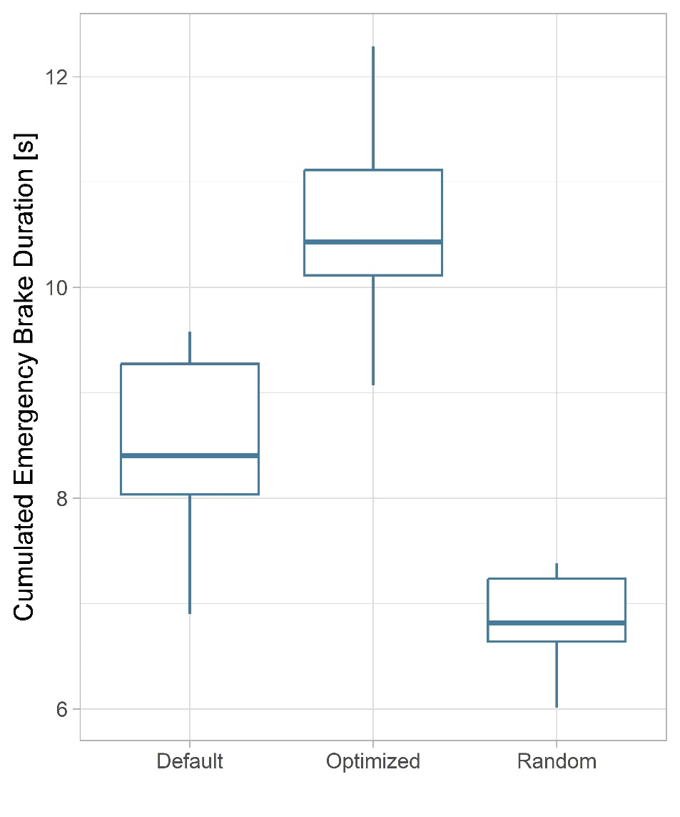
Evaluation: Start Scenario 1

Slide 12
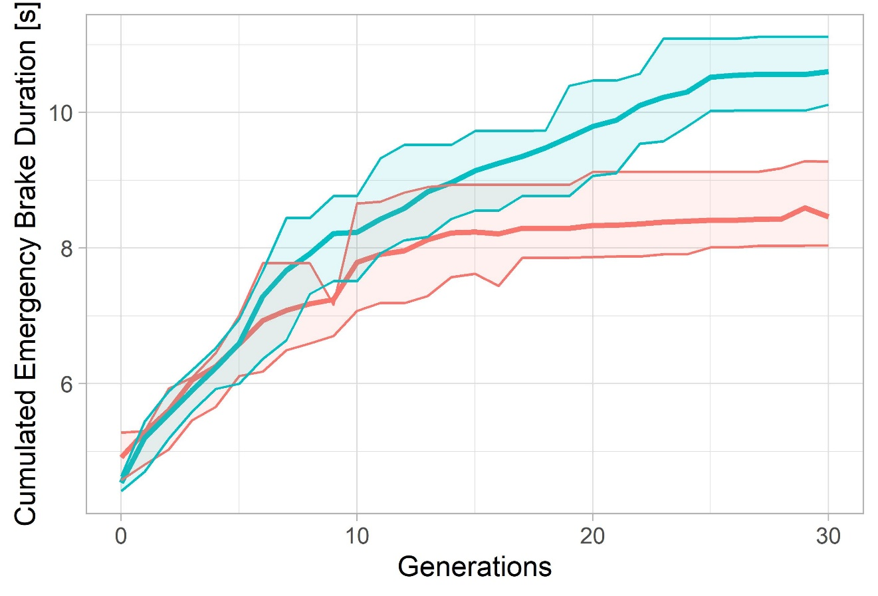
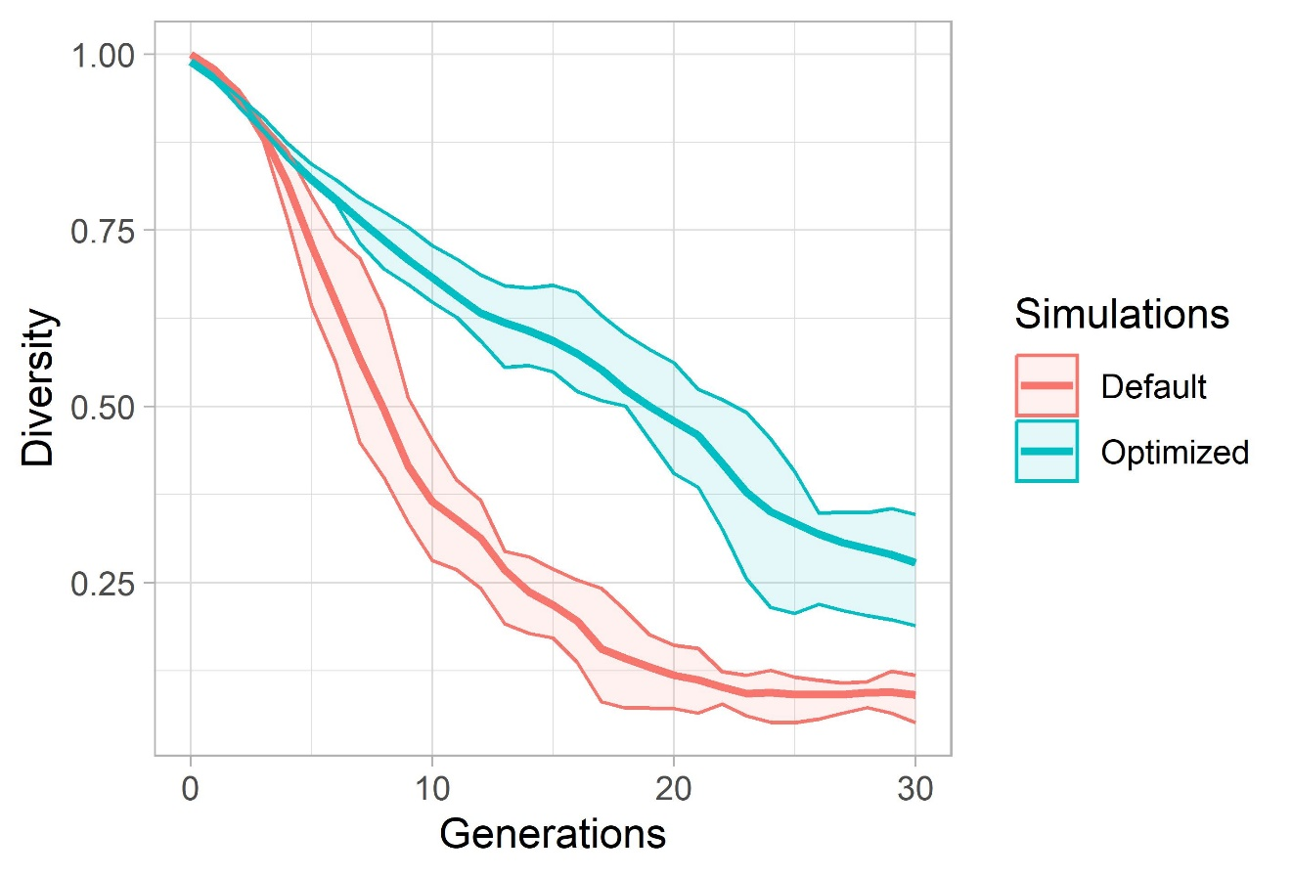
Evaluation: Start Scenario 1

Slide 13
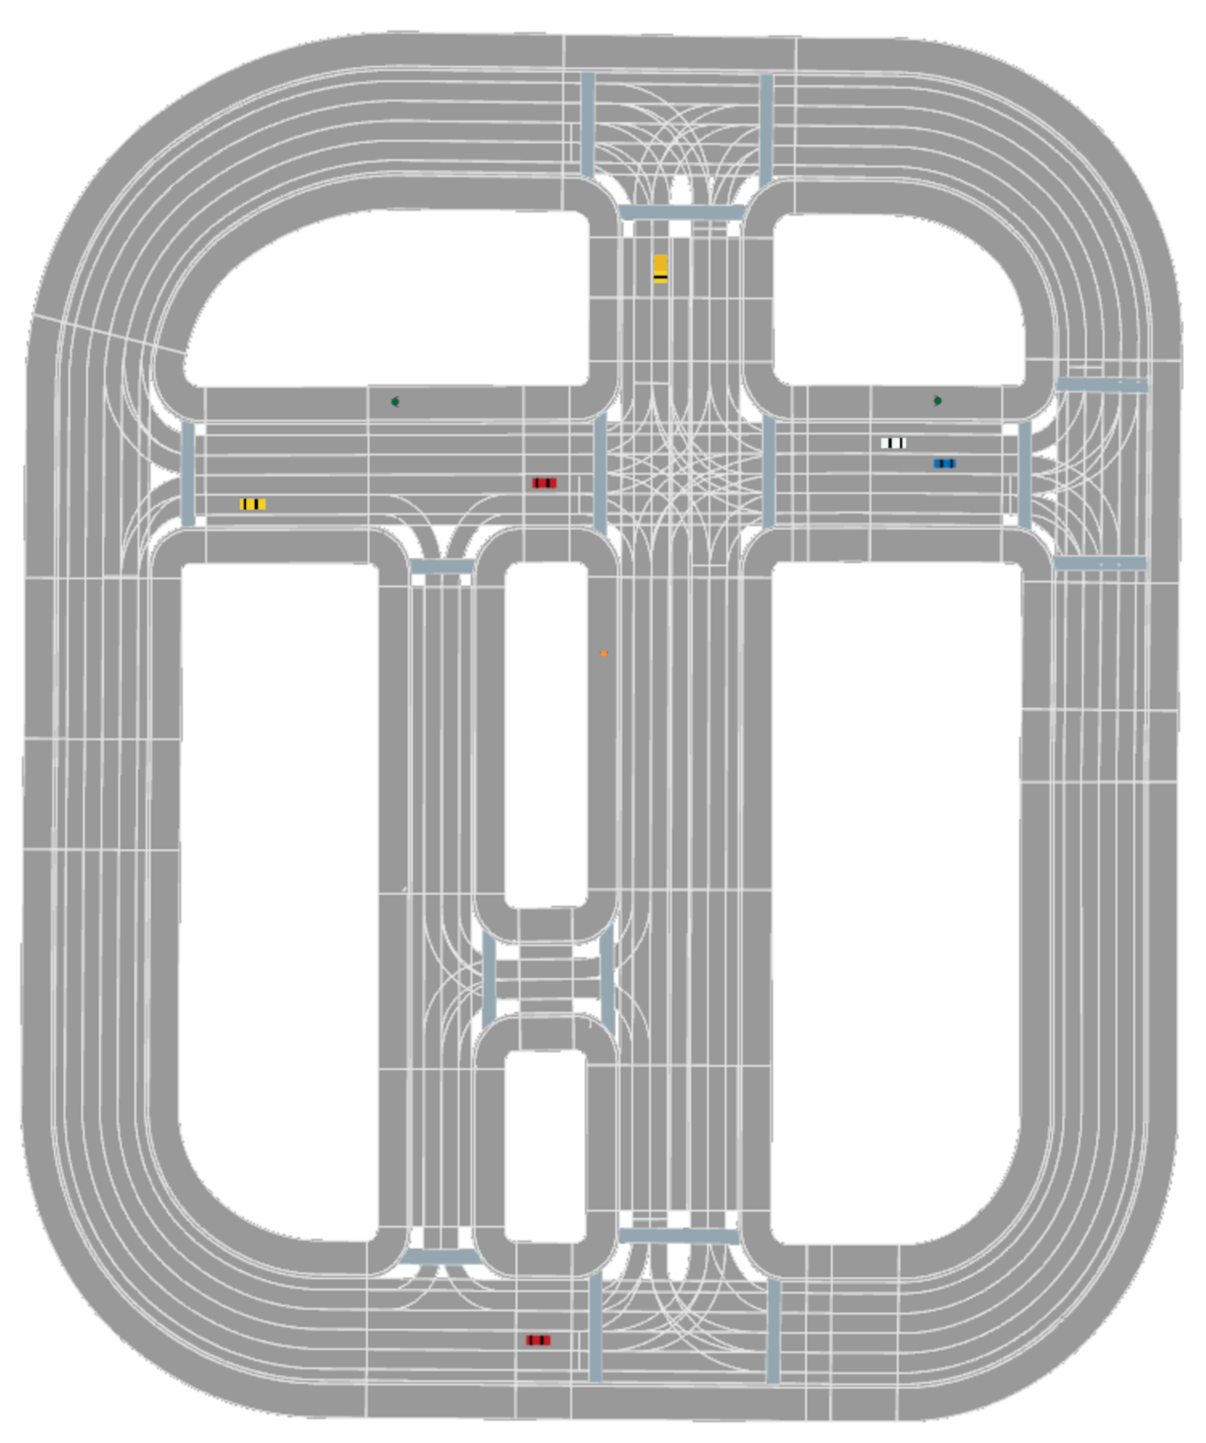
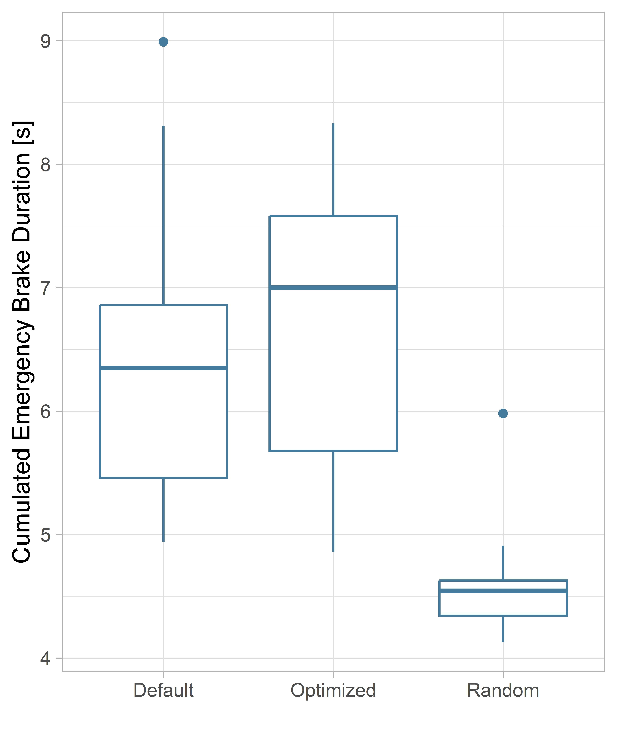
Evaluation: Start Scenario 2

Slide 14
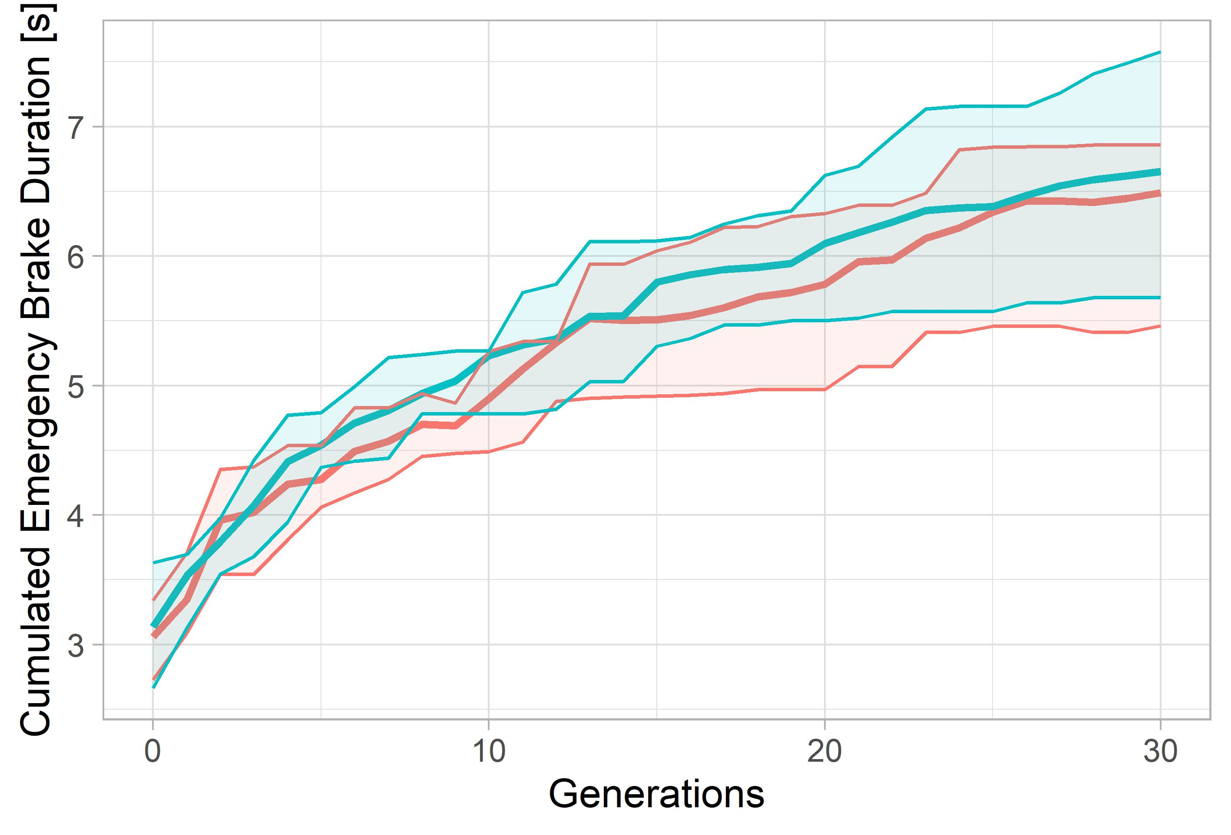
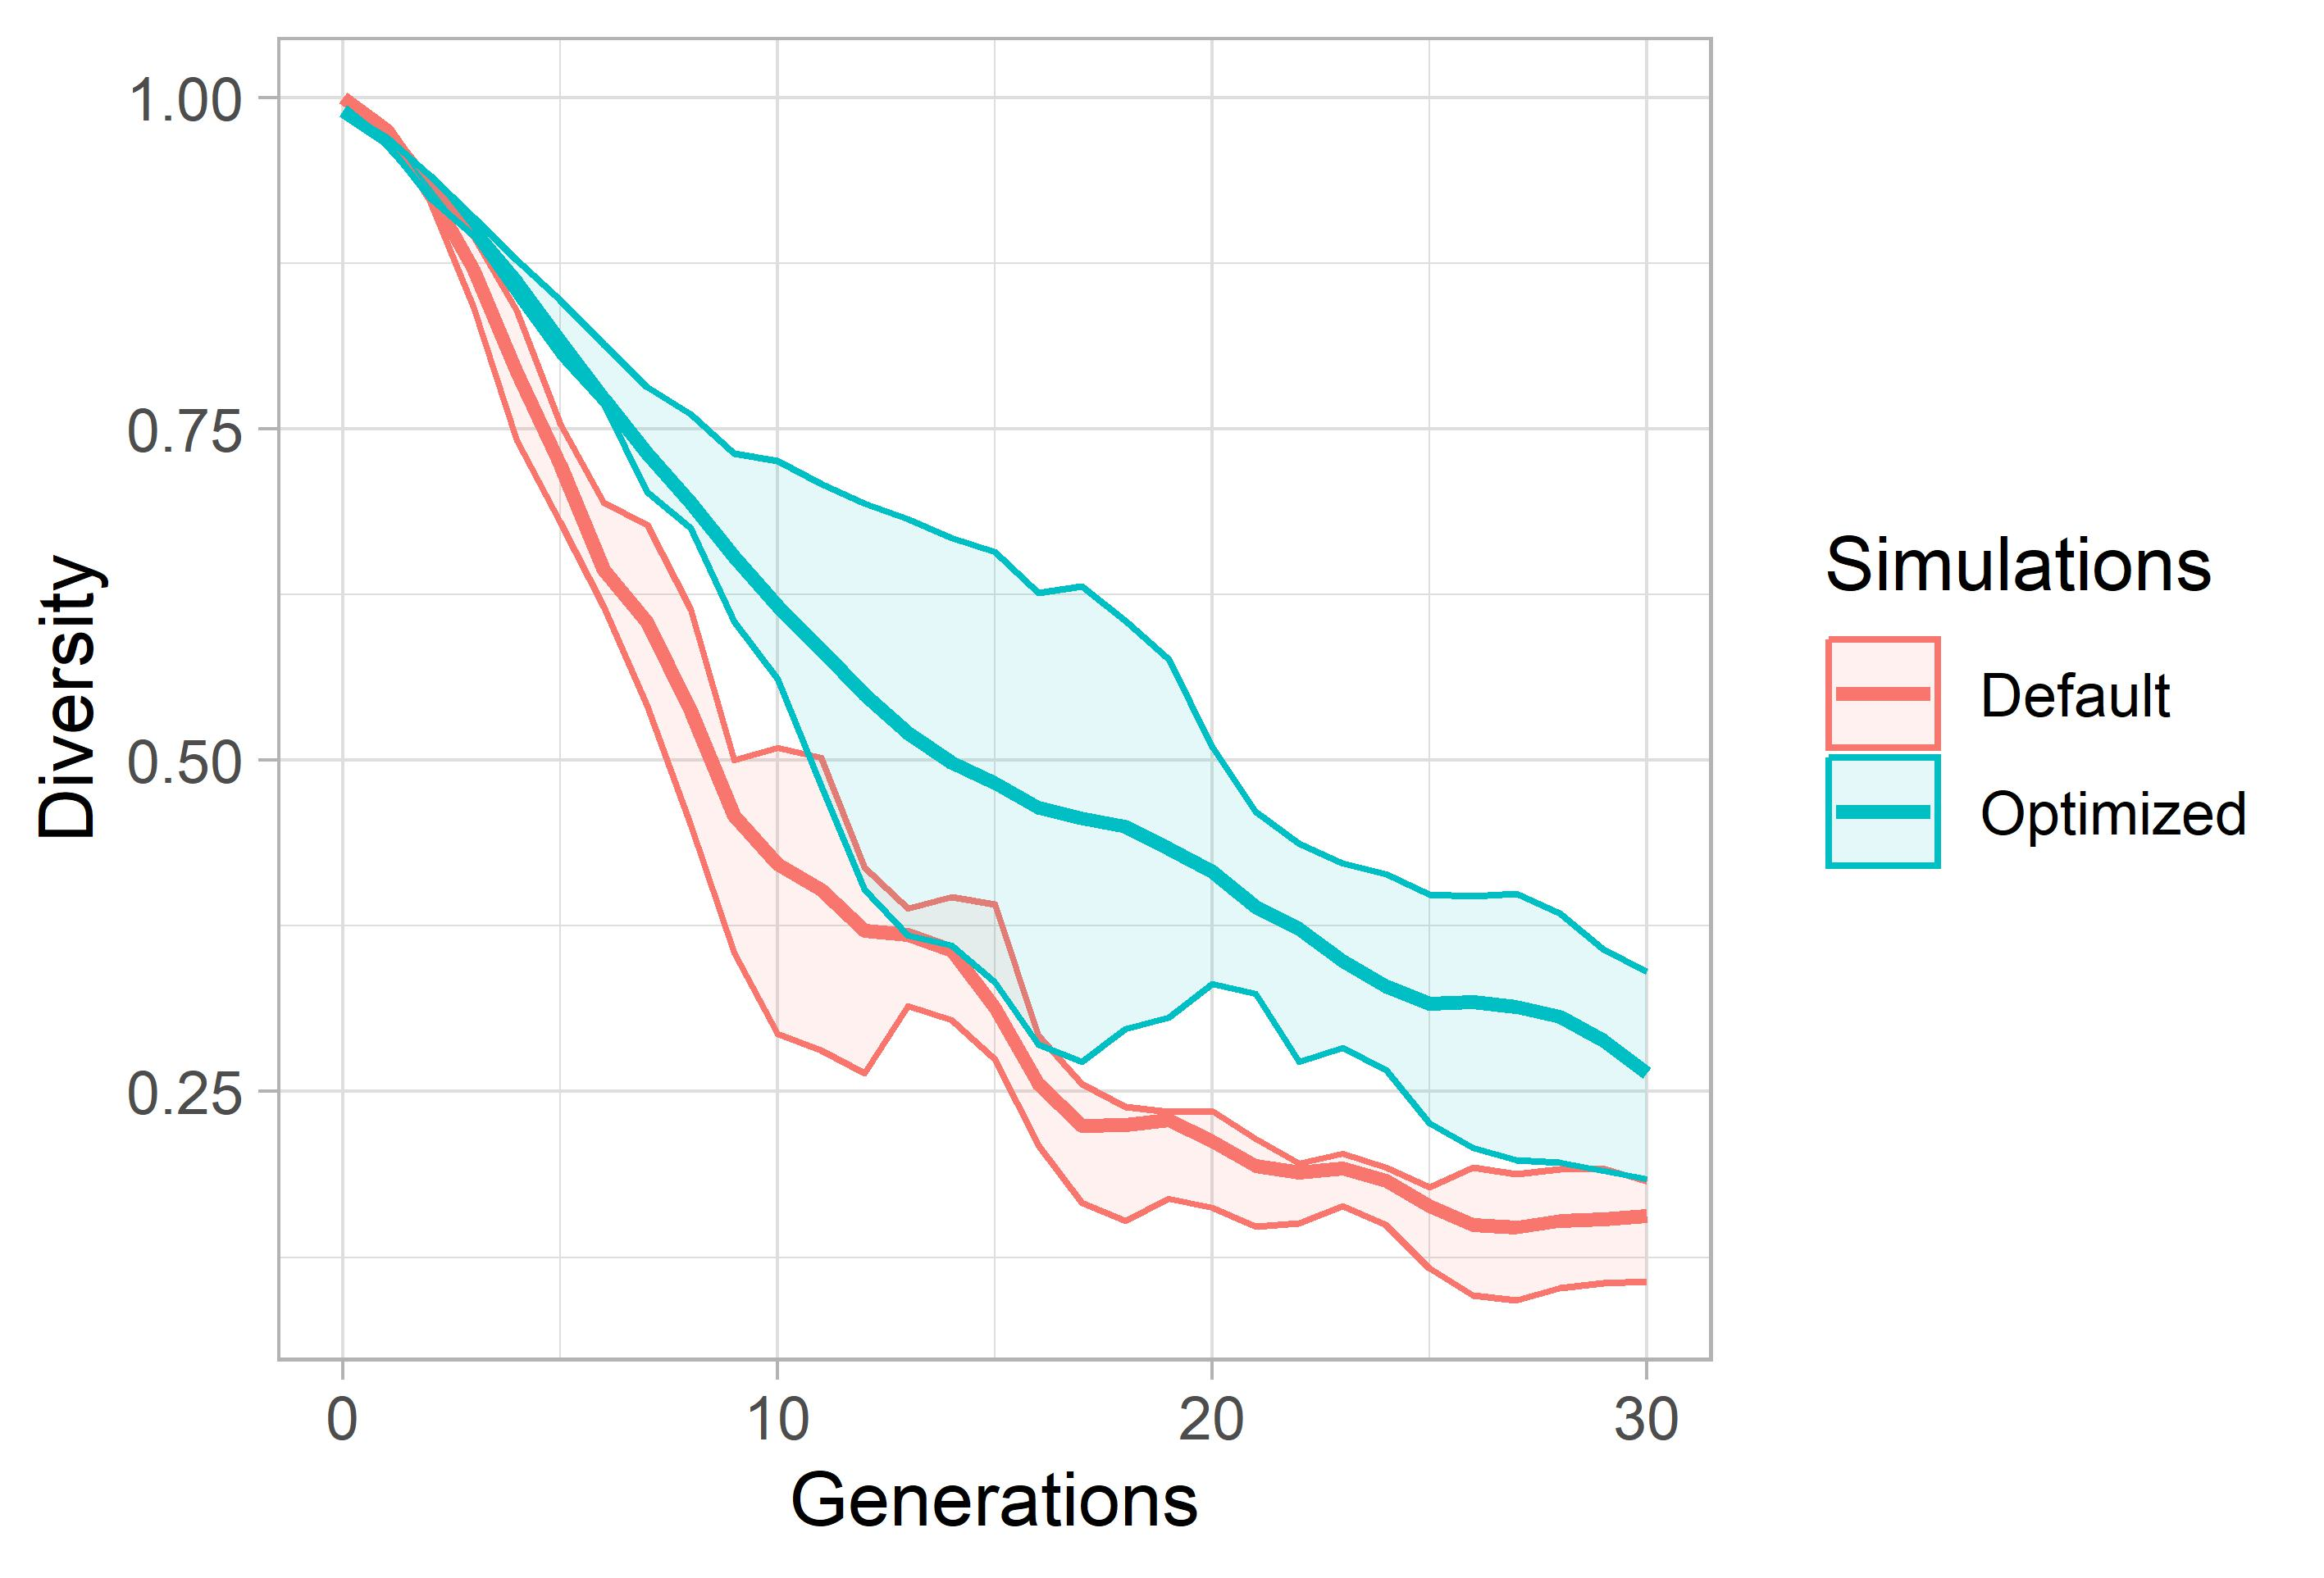
Evaluation: Start Scenario 2

Slide 15
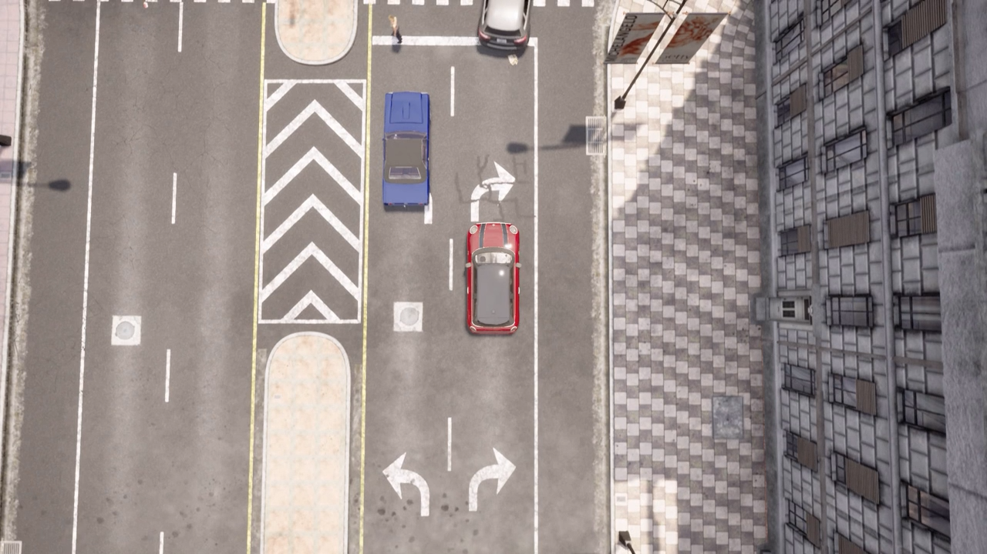
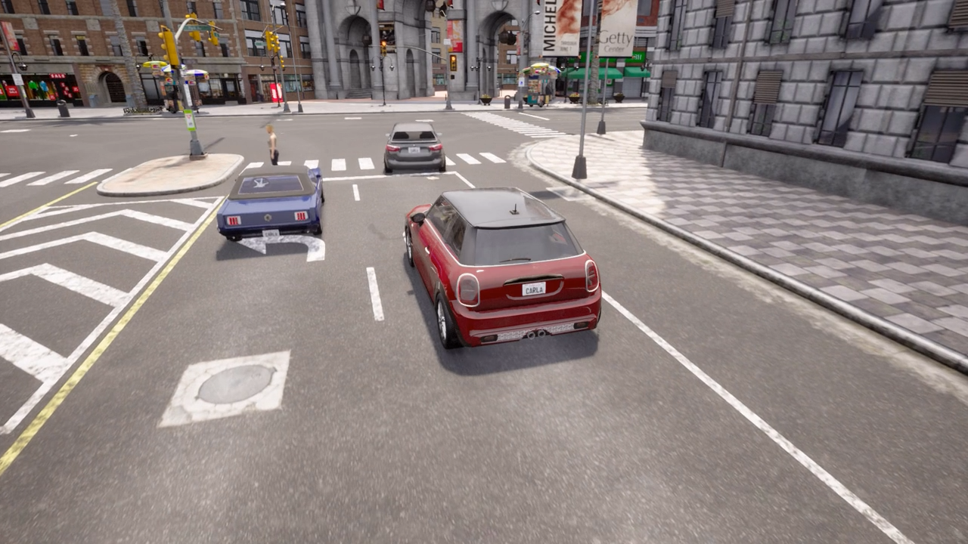
Critical Situation 1
After pedestrian crossing
NPC vehicle cuts shortly before junction and violates path of EGO vehicle
EGO vehicle has to emergency break

Slide 16

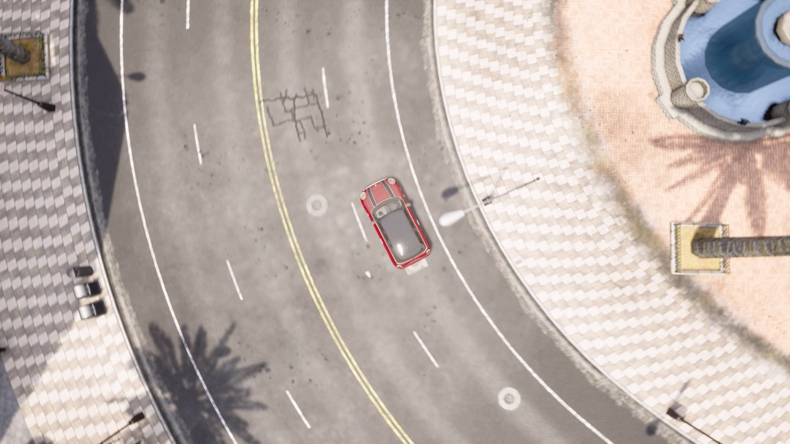
Critical Situation 2
Inside junction
NPC vehicle ignores right of way
EGO vehicle has to emergency break

Slide 17


Critical Scenario 3
Kid runs over road
Kid is occluded by Truck
EGO vehicle (blue) has to emergency break

Slide 18
Thank You!

